Slide 1
RazKey
By: Nicholas Hardy, Kaede Kawata, James Sullivan, Yen Vo

Slide 2
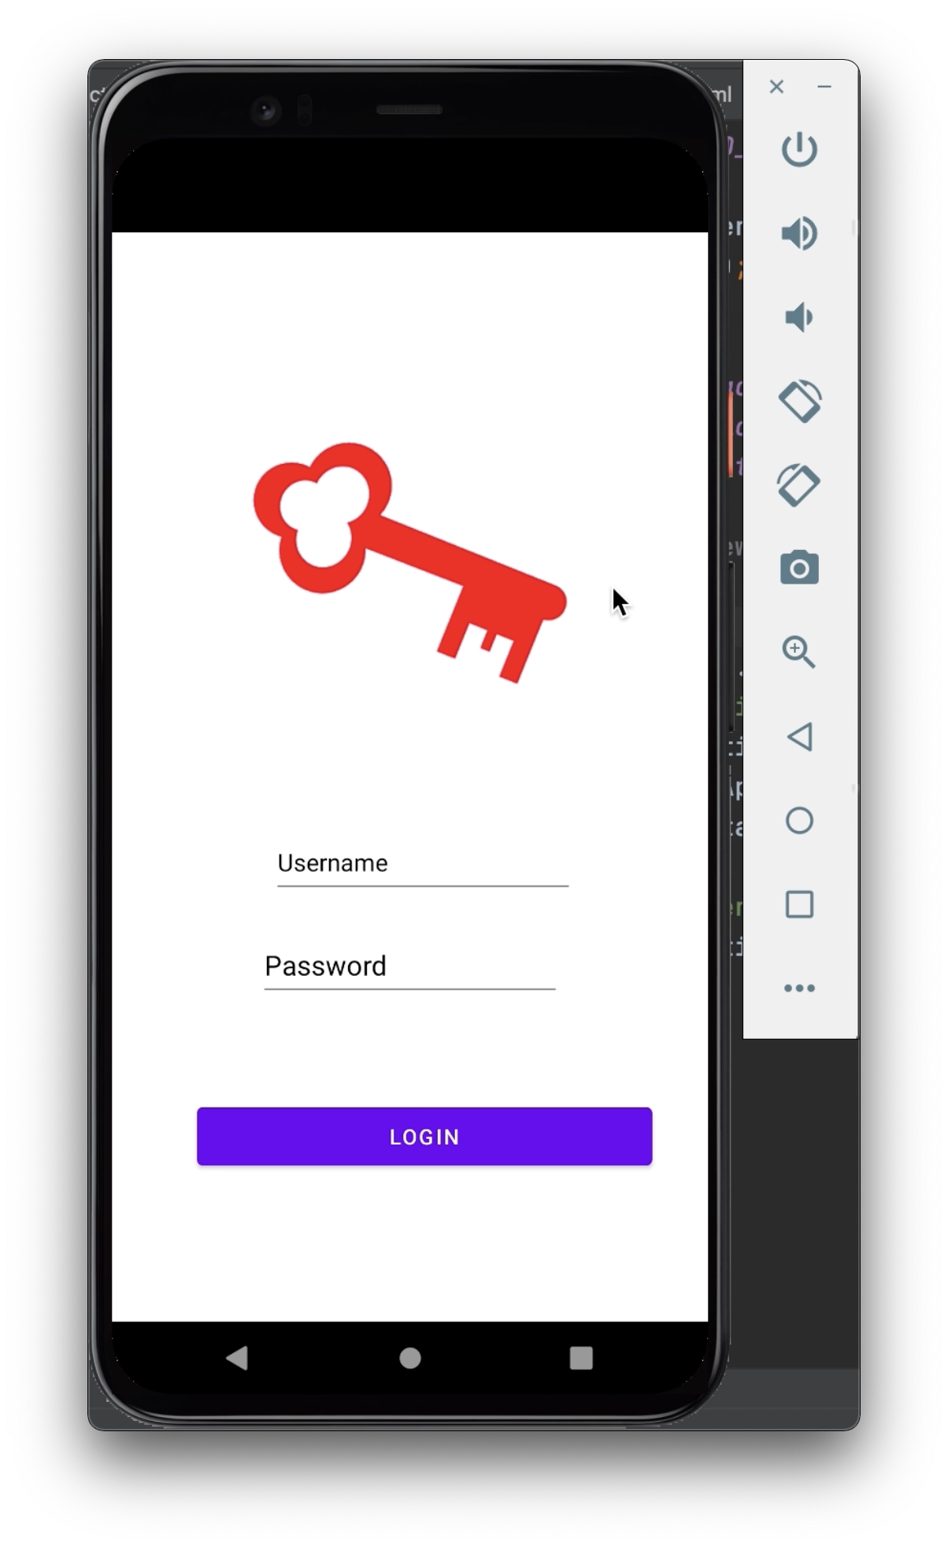
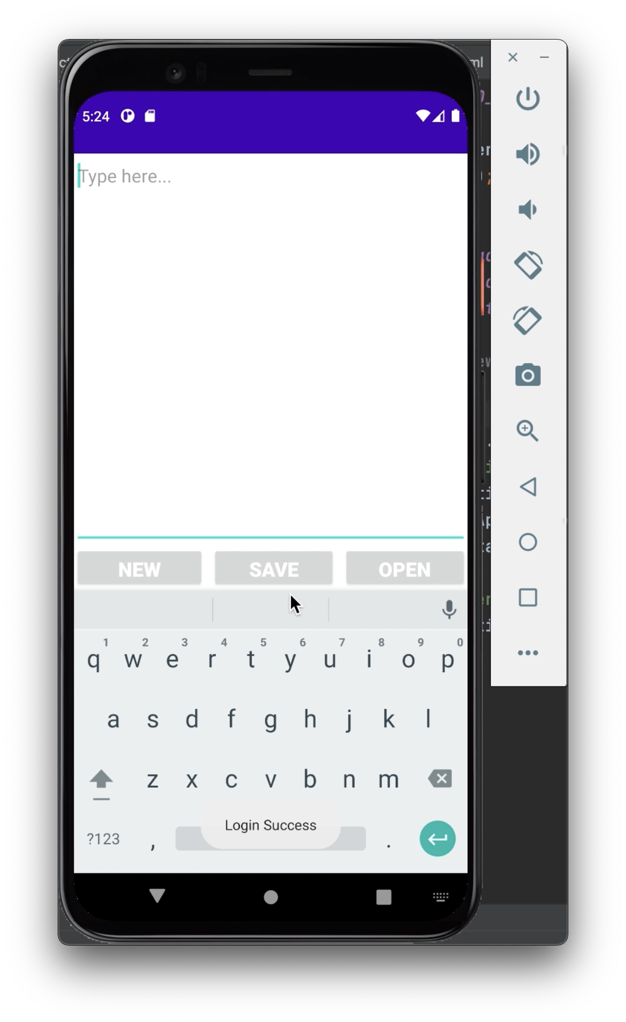
Login Screen
When the user opens the app they are prompted to enter their username and password in order to log in

Slide 3
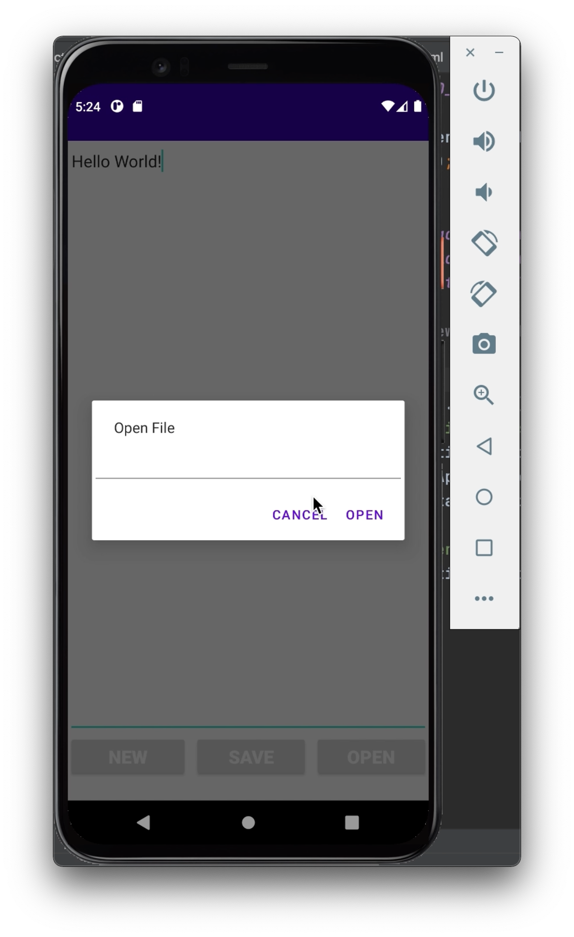
Menu Screen
Logging in brings you to a notepad where new information can be written
Files can be accessed from the ‘OPEN’ button
Written data gets saved by pressing the ‘SAVE’ button
The ‘NEW’ button opens a new notepad file

Slide 4
The intended functionality and appearance...

Slide 5
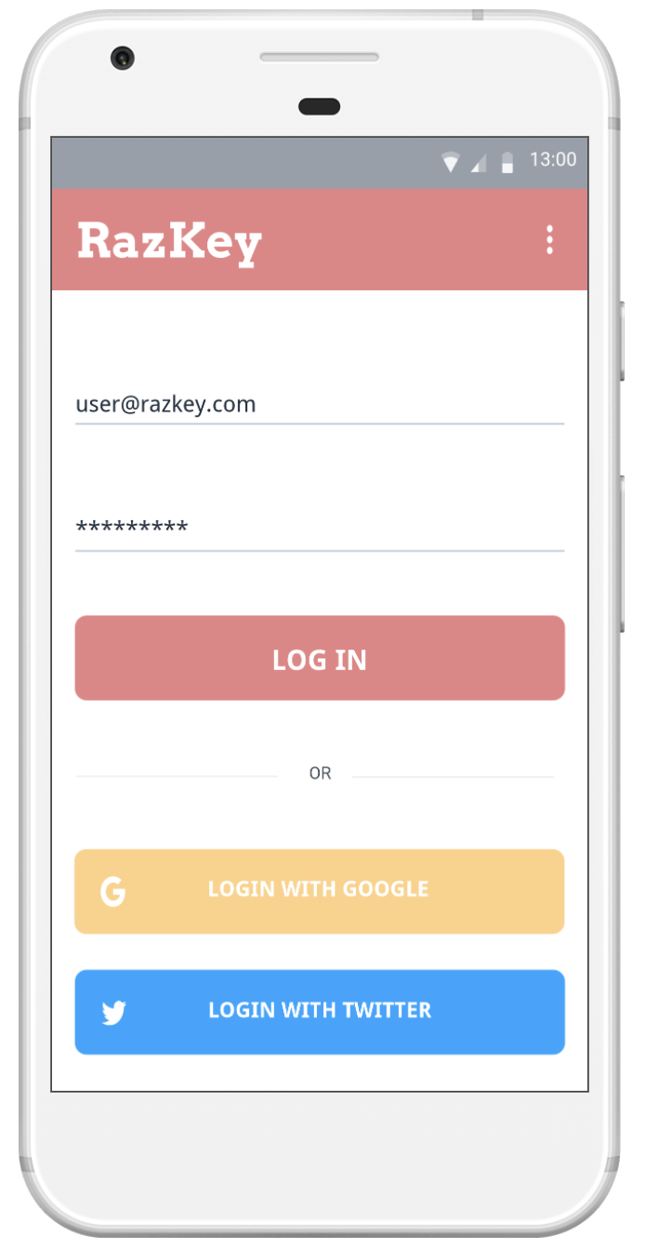
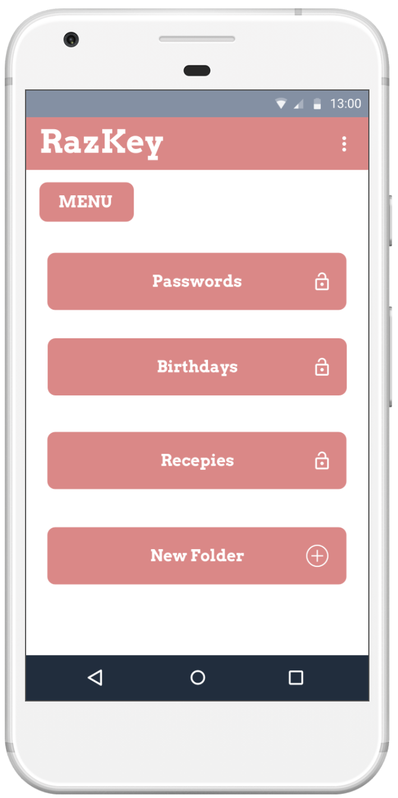
Login Screen
When the user opens the app they are prompted to enter their username and password in order to log in.

Slide 6
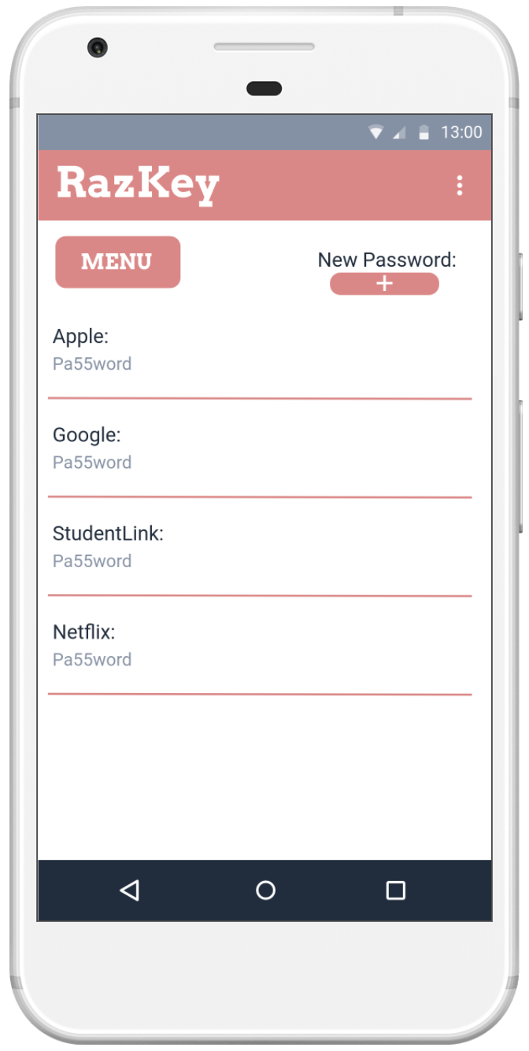
Menu Screen
With different folders, the user can select which folder to access
by clicking each button they will be directed to a new screen
*All subfolders have the same characteristics as the demonstrated ‘Passwords’ button*

Slide 7
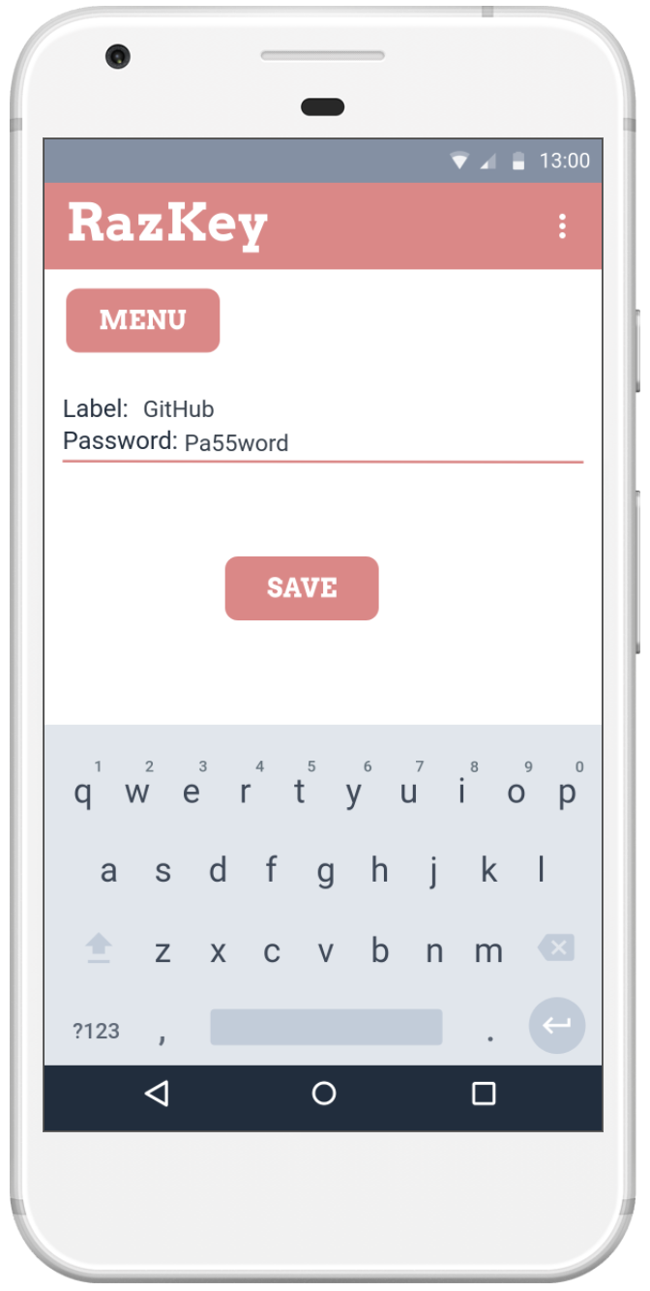
Passwords
if the user pressed the ‘New Password’ button they are redirected to a keyboard and new password entry
pressing the save button returns back to the passwords screen while saving the password

Slide 8
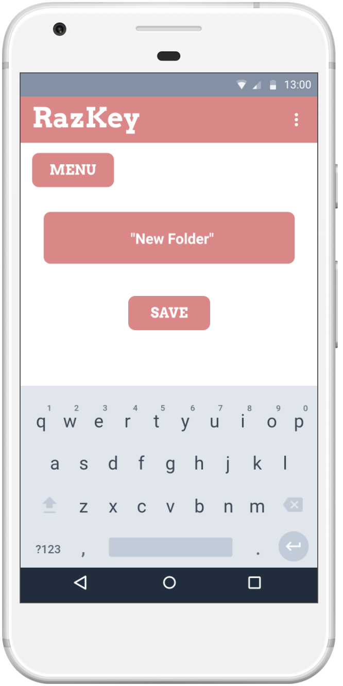
New Folder Creation
Creating a new folder creates a new .txt file in while the program will write to

